Slide 1
Safety Properties of Inductive Logic Programming
Gavin Leech, Nandi Schoots, Joar Skalse

Slide 2
Why care?
Q: Paradigms with better safety, to substitute or complement DL?
Case study in estimating safety potential
Analyse the old hunch: "Symbolic approaches safer than neural"
Kinds of hybrid systems that are viable and useful

Slide 3
What’s ILP?
Symbolic supervised learning: inductive logic + logic programming
h ← ILP(E⁺, E⁻ , B)

Slide 4
The dream:
Expert elicitation → knowledge representation, discovery
Predicate invention: ~ representation learning
All in interpretable steps, with interpretable results

Slide 5
How do we evaluate safety?
“SRA” (Ortega and Maini):
Specification (impose properties, value loading);
Robustness properties;
Assurance properties (interpretability; verification; control of bias)

Slide 6
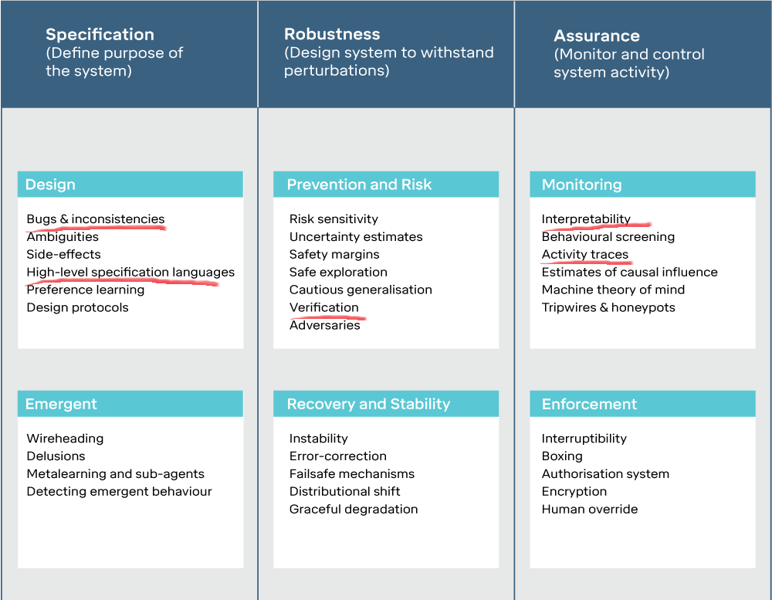

Slide 7
Safety(ILP) vs Safety(DL)
We cover 6 properties, but top 3:
ILP models are transparent and reasonably accessible
iff data already available on a symbolic level!
ILP is convenient for specification,
iff examples and properties of correct behaviour are in FOL
ILP more promising for verifying
can verify whether an ILP model satisfies a spec by logical resolution

Slide 8
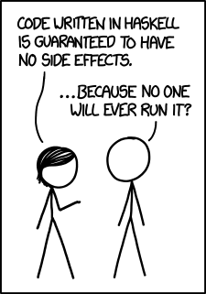

Slide 9
But! ILP performance lags
No longer competitive
Massive space complexity (exponential in hypothesis length)
Expressiveness of FOL → search over large discrete spaces, in NP^{NP}
Handcrafting task-specific inductive biases
No ~ architecture search
The deep threat to knowledge representation

Slide 10
Risks from neural-symbolic hybrids?
Two boundaries, thus risk of info loss
No accessibility (algorithm transparency)
Low control over inductive bias
No hard constraints
Symbol Subsymbol Symbol
input inference output
risk! risk!

